Slide 1
Grainger – SVOT & Tenancy Review
SteerCo Update
4th June 2025

Slide 2
Project Overview & Objectives
Project Timeline
Demo
Risks, Assumptions, Issues & Dependencies
Q&A

Slide 3
Project Overview
This project will deliver a bespoke tenancy review journey within Salesforce that is efficient, improves visibility into supporting information, maintains a full history of associated activity, and provides an improved customer experience.
Given the timing of the project, the process is designed to align with the upcoming Renters’ Rights Bill.
In order ensure complete and accurate tenancy data is driving the tenancy review process, a foundational release will create a single view of tenancy within Salesforce that is aligned with Qube, as the system of record for tenancy data.

Slide 4



Objectives
Single View of Tenancy
Create the Concept of a Tenancy in Salesforce
Align Salesforce & Qube tenancy data models.
Map Salesforce tenancies directly to Qube tenancies.
Foundation to simplify future integrations.
Provide Single View of Tenancy
Provide a single view of all tenants & related parties, associated opportunities, and contracts within Salesforce.
Link related tenancies.
Data Accuracy & Completeness
Visibility into all current residential tenancies in Salesforce.
Maintain an accurate record in Salesforce of which tenancies and tenants are current & who has vacated.
Trusted data from which tenancy review opportunities may be reliably created.

Slide 5



Objectives
Tenancy Review Process
Reliable Platform for Collaboration
Single source of truth.
Replace the offline renewal spreadsheets.
Replace the existing, unreliable tenant portal for renewal offers.
Prepopulate Inputs to the Tenancy Review Process
Remove the need to cross-check information between Excel spreadsheets, Salesforce and Qube.
Eliminate manual input of Price Book Rent & ERVs.
Provide latest tenancy arrears balances & rent within Salesforce.
Alignment with the Renters’ Rights Bill
Generate Section 13 notices.
Highlight tenancy reviews at risk of missing deadlines.

Slide 6
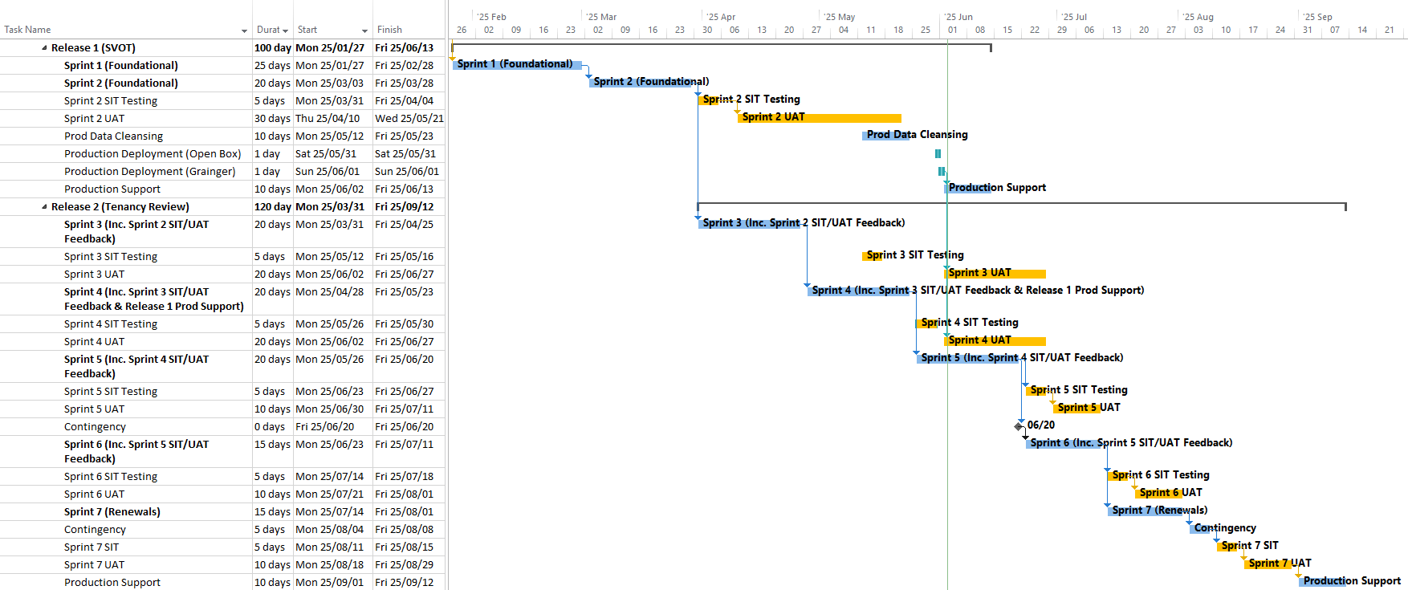

Timeline
Release 1 Go-Live
Release 2 Go-Live

Slide 7
Demo

Slide 8
Risks, Assumptions, Issues & Dependencies
Category | Description | Impact | Next Steps / Decisions
Assumption | Renters’ Rights Bill expected to come into effect between Sept 2025 and Jan 2026. | Functionality designed for Renters’ Rights will likely go live before the legislation comes into effect. | Grainger to move any tenancies that come up for renewal to periodic after Sept go-live, issuing existing S13 documents.
Risk | Renters’ Rights Bill comes into effect before Sept 2025. | Functionality is not ready & it is not feasible to manually generate high volume of S13 documents. | Grainger will maintain compliance by deferring rent increases.
Risk | Details of Renters’ Rights Bill not finalised until after go-live. | Functionality will generate current S13 documents | Enhancements & new document templates may need be implemented after go-live.
Decision | Process to manage S13 formal challenges will be addressed as a separate project. | Additional development may be required & the new process may not be available day 1 when legislation comes into effect. | Existing process to manage formal challenges to continue in the interim. New process to be confirmed once legislation is finalised.

Slide 9
Any Questions?

Slide 10
Thank You

Slide 11

Appendix - Features

Slide 12



Release 1 Features – Single View of Tenancy
Align Salesforce & Qube tenancy data model. Create the concept of a tenancy in Salesforce that maps directly to Qube tenancies.
Create new residential tenancies in Salesforce on completion of a new lease opportunity, linked to the Qube tenancy.
Update tenancies in Salesforce on completion of renewal or mid-term change of sharer opportunity.
Maintain the existing contract version history.
Ensure contracts reflect the correct active / ended / draft status.
Maintain an accurate record in Salesforce of which tenancies & tenants are current and which have vacated, as well as move in and move out dates for each tenant, that is consistent with Qube.
When viewing a tenancy, users can see a full history of tenants and associated parties.
A once-off data migration will create all existing, active residential tenancies in Salesforce.
Key tenancy details (such as status) are updated from Qube.
New tenancies created directly in Qube are pushed to Salesforce via GREP integration.
EOTs are created for a tenancy, not contract.
Provide a single view of all tenants, related parties, associated opportunities and the existing tenancy version history within Salesforce.
When viewing a residential tenancy, users can view a full history of associated opportunities and underlying contracts.
Link decant agreements & parking / shed licences to the primary tenancy.
See a history of tenancies for a unit.
See a history of tenancies linked to an account

Slide 13






Release 2 Features - Prepopulate Inputs to Tenancy Review Process
Import current & prior rent for each unit into Salesforce which will be visible as part of SVOT.
Daily import from the data warehouse.
Current & prior rent is visible on each unit, tenancy and tenancy review opportunity.
Maintain & view a full history of ERVs, monthly price book rent and licence prices for each unit.
Enable support users to upload spreadsheets of Price Book Rent, Grainger Trust prices, licence prices & ERVs as and when updated.
See current tenancy arrears as part of SVOT.
Import the current arrears balance from the data warehouse per tenancy, on a daily basis.
Enable PMs / RSMs to maintain block-level pricing information.
Asset Managers can see block-level pricing information when reviewing renewal pricing.
Provide a new dashboard that displays recent rent achieved & available units by estate & unit type.
Easily access relevant information when viewing tenancy review opportunity.
Identify Grainger Trust units that don’t need to be Priced by Asset Management.
Import unit tenure from Qube.
See tenure for a unit, tenancy and tenancy review opportunity.

Slide 14



Release 2 Features - Replace Spreadsheet & Renewals Portal
Automatically create tenancy review based on
accurate tenancy data, replacing the lease end diaries in Qube.
Create tenancy review opportunities based on up-to-date tenancy data.
Users can manually create an opportunity.
The opportunity layout, fields & stages are customised for the tenancy review process.
Prepopulate offer details.
Manage a Next Rent Review Date for rolling tenancies.
Migrate next rent review date from Qube diaries.
Enable Asset Managers to see upcoming rent reviews, ERVs, price book rent & set an offer and minimum price.
Notify Asset Managers to review pricing.
AM reviews a list of tenancy review opportunities for which they are responsible.
See the latest ERVs, price book rent & current rent.
See unit information that impacts pricing.
Ability to review by estate & unit type.
Excludes Grainger Trust tenancies.
Highlight pricing reviews required urgently.
Replace the existing ‘Summary’ worksheet in the Renewals spreadsheet with a dashboard that enables Asset Managers to see growth on rent by asset and region.
Asset Managers can review monthly rental growth on ERV and on current rent, by portfolio & estate.
Rental growth is based on the minimum price, incorporating any approved counteroffers below minimum.

Slide 15



Release 2 Features - Replace Spreadsheet & Renewals Portal
Enable Tenancy Review Negotiators to see outstanding information and tenancy reviews at risk of missing a deadline at a glance.
Tenancy Review Negotiators access a list of opportunities relevant to them & ready to be worked on.
Negotiators can see at a glance:
  Current arrears balance & where a decision is required from credit control.
  COS requested & related progress.
  Tenancy issues
  Outstanding right to rent
  If eviction initiated
  Deadlines / due dates.
Tenants respond to advance notification of rent increases online by accepting or making a counteroffer
Tenants receive an email with a link to review offer details & accept, make a query or motivate a counteroffer via Form Assembly screens embedded in Grainger website.
Send reminder SMS with a link.
Each tenant receives notification & can respond separately.
See where a tenant has viewed an offer.
Maintain a full history tenant responses.
Manually capture offer responses received offline.
Negotiators review & respond to counteroffers, requesting Asset Management approval where necessary, maintaining a full history of offers and counteroffers
Tenancy Review Negotiators review the tenant's counteroffer and may enter a recommended price & reasoning.
Automatically create a new offer where recommended price is above minimum, or request approval from the Asset Manager where below minimum.
Asset Managers review and accept or reject counteroffers, or enter alternate price.

Slide 16





Release 2 Features – Renters’ Rights Bill
Cater for periodic tenancies and contracts.
Enable capture of new lease and tenancy review opportunities with no term.
Automatically set / update the next rent review date.
Generate and email Section 13 notices to tenants.
See history of §13 documents sent to tenants.
Generate alternate documents & use different email templates for non-AST tenancies.
Generate RHW13 documents for Welsh tenancies.
Customized email content notifying tenants of upcoming tenancy review per agreement type.
Update chase cycles & emails where tenants need to accept an offer or sign a contract (Live Work & company lets).
Remind Negotiators to follow-up on unsigned contracts.
Automatically close a tenancy review opportunity when an End of Tenancy is initiated.
Notify the Tenancy Review Negotiator.
Enable PMs/RSMs, Asset Managers & Negotiators to defer a tenancy review to a later date.
Ability to defer a tenancy review before or after the opportunity has been created.
See deferred date & reason on the tenancy.
Asset Managers can defer in bulk.

